Slide 1



DBMS Miniproject
By,
Divya P (23CDR045)
Haridha M (23CDR051)

Slide 2
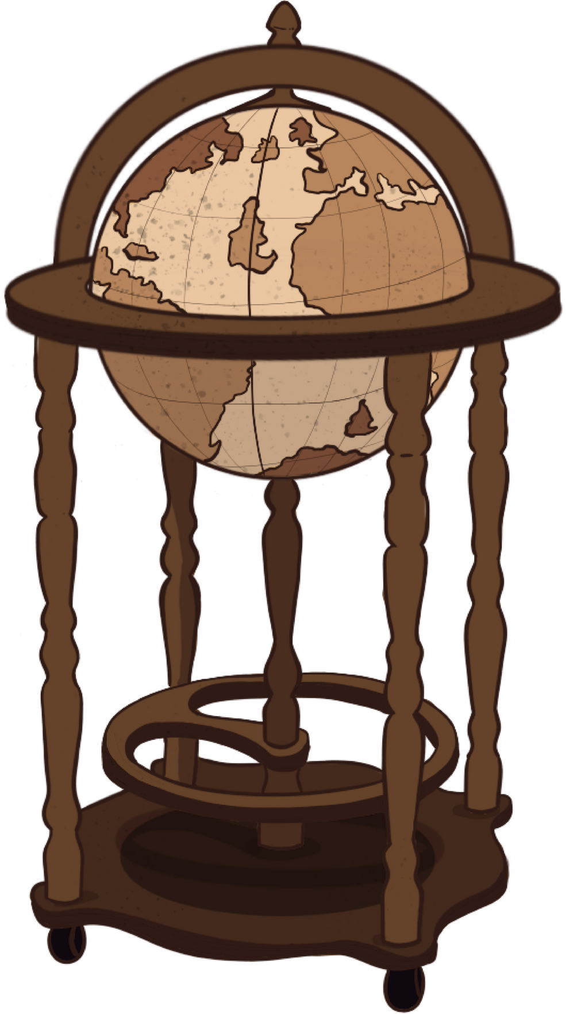
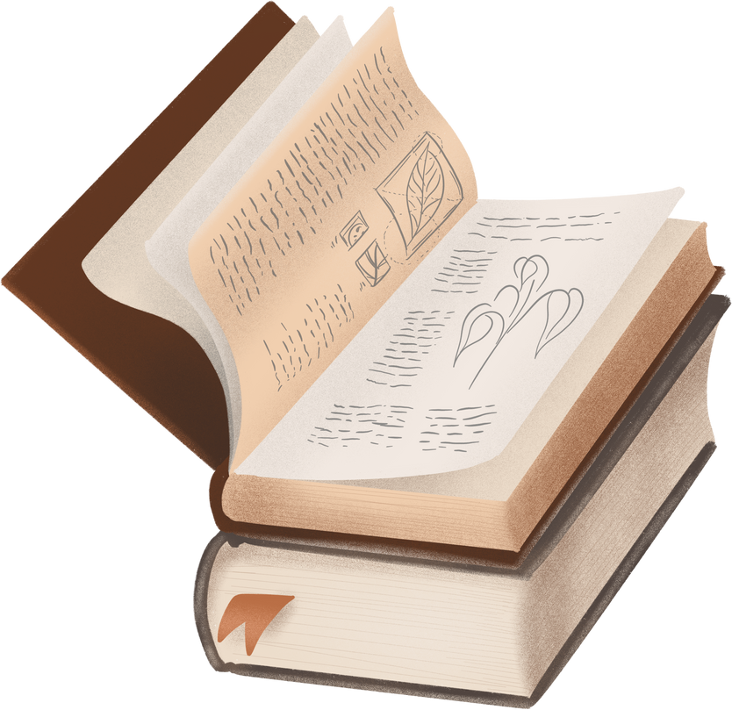
Project Info
Project Title:
Task Management Application
A Task Management Application that allows users to create, assign, and monitor the progress of tasks within various projects. It supports setting deadlines, updating task statuses, and managing team collaboration effectively.

Slide 3
Problem Statement
Managing tasks efficiently is crucial in academic and organizational settings, yet many users face challenges such as:
Lack of centralized task tracking.
Difficulty in meeting deadlines.
Poor collaboration and task visibility.
Manual and inefficient task allocation methods.

Slide 4
Proposed Solution
Develop a Python-based Task Management Web Application that provides:
An intuitive interface to create, update, and delete tasks.
A backend built using Python (Flask/Django) to manage task logic and database operations.
Integration with an RDBMS (e.g., MySQL or SQLite) for persistent data storage.
Support for deadlines, status tracking, and future assignment features.

Slide 5
Project Goals
Task Lifecycle Management
Python-Powered Backend
Database Integration (SQLite)
Simple and Clean Frontend
Extendability and Modularity

Slide 6
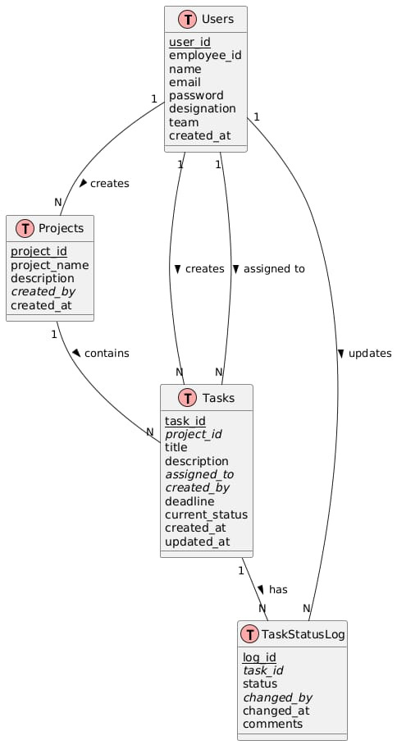
ER DIAGRAM

Slide 7
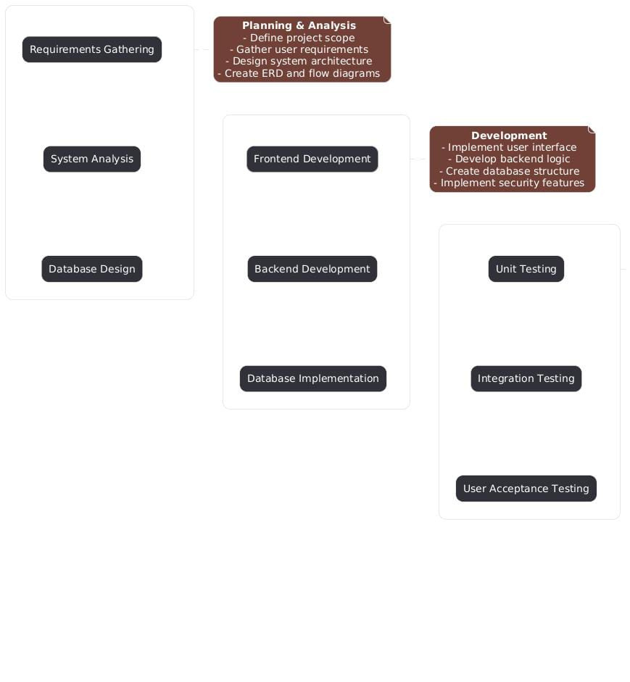
Flow
Diagram

Slide 8
- User Management
* Registration
* Authentication
* Role-based access
- Task Management
* Create tasks
* Assign tasks
* Update status
* Set deadlines
- Project Organization
* Create projects
* Assign tasks to projects
* Track project progress
- Status Tracking
* Real-time updates
* Status history
* Comments
Features

Slide 9
Database Schema
Project Structure
Detailed table structures
Field descriptions
Data types
Constraints
Indexes
Directory organization
File naming conventions
Code organization
Configuration files
Core components

Slide 10
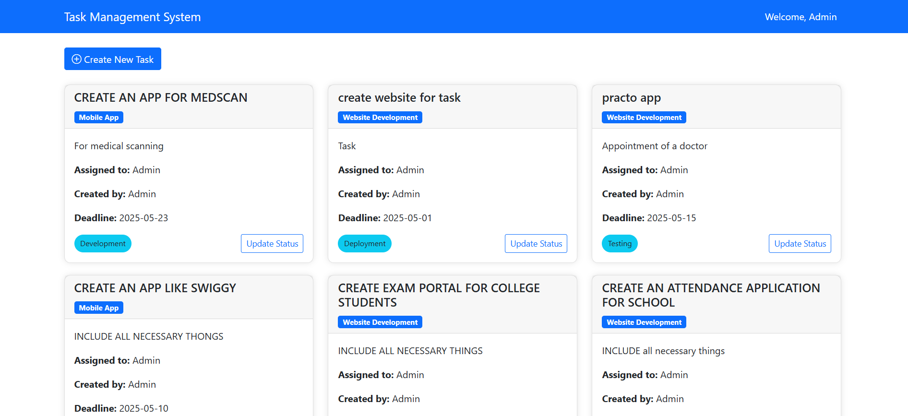
Output

Slide 11
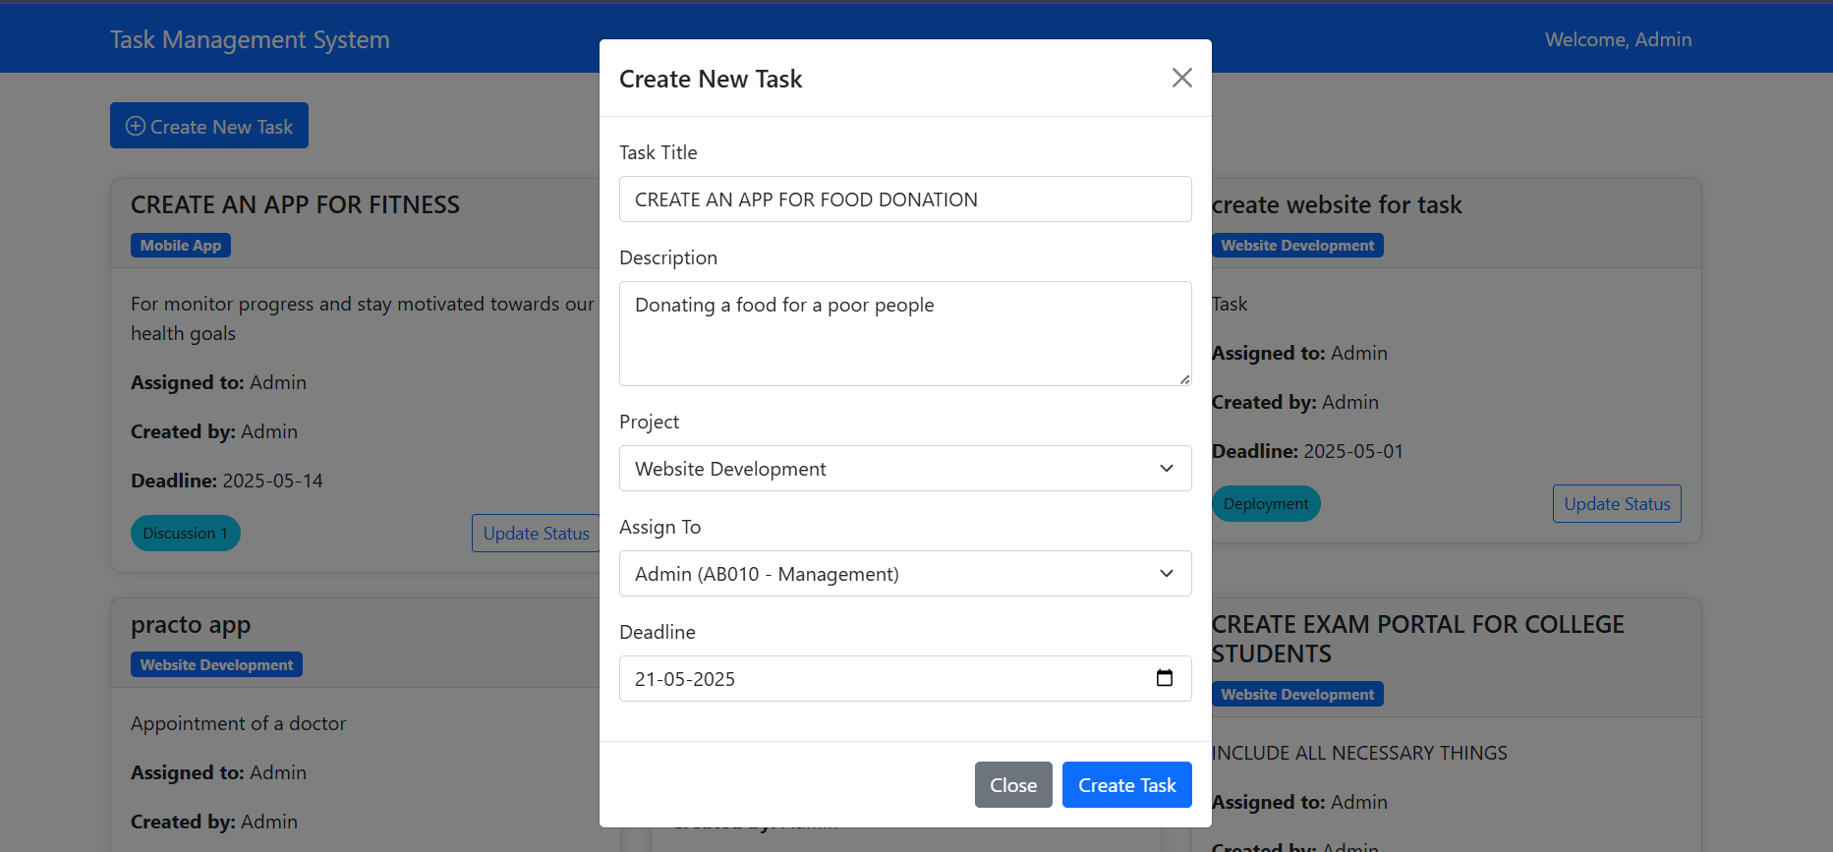

Slide 12
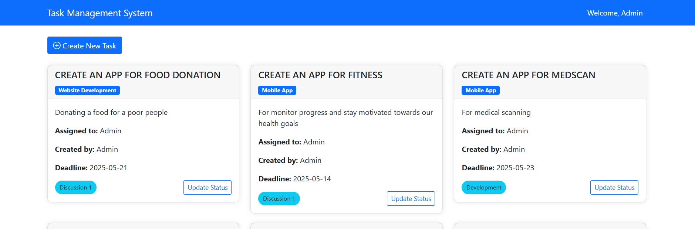
Task Created

Slide 13
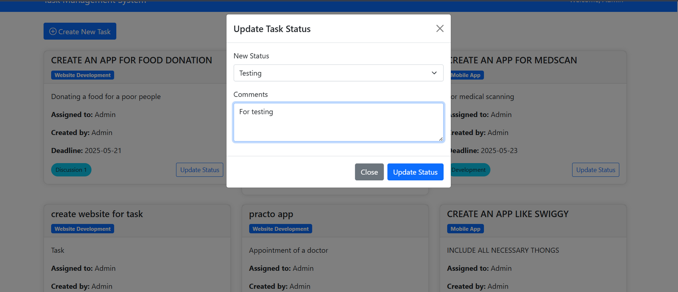
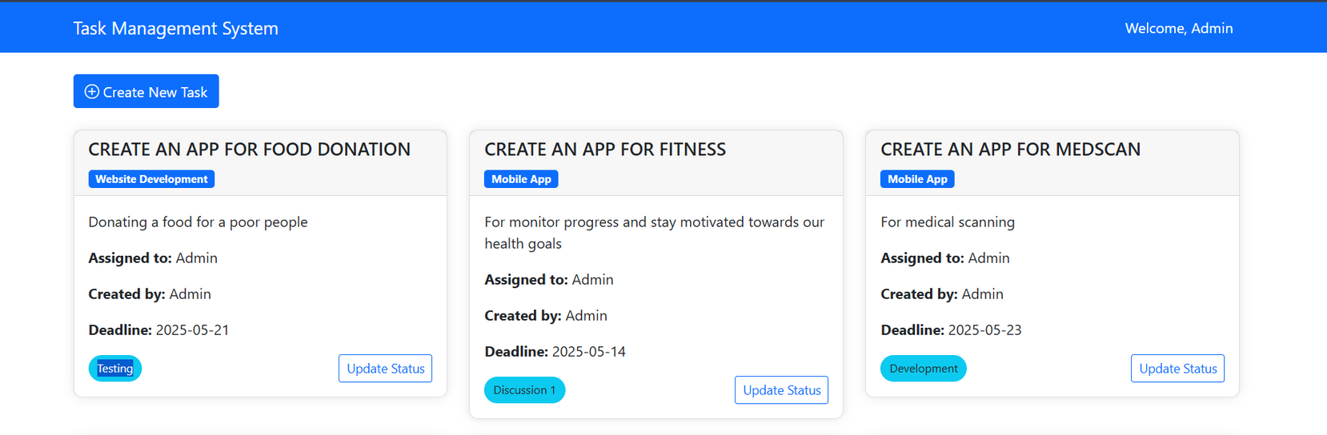
Update
task

Slide 14
Conclusion
The task management system helps organize work efficiently in real-time.
It ensures clear assignment of responsibilities and timely completion of tasks.
Users can easily track progress and manage deadlines from a single platform.
Overall, it improves productivity and collaboration within any team or organization.

Slide 15
Thank you

